Slide 1
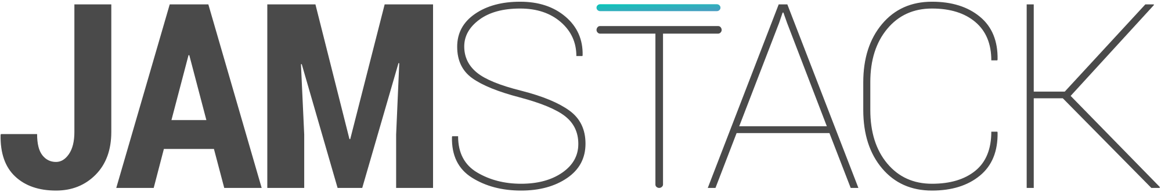
Notes:
Joe Zack, a full-stack dev, focused on BE
Talking JAMstack, which is a front-end focused methodology for building web apps that has recently caught my eye.
What the JAMstack is
Why it’s gaining popular
What it means for BE devs

Slide 3
JAVASCRIPT
API
Markup

Slide 4
JAVASCRIPT
API
Markup

Slide 5
CDN are the best!
Performance
Scalability
Cost
Notes:
TODO Get numbers

Slide 6
Notes:
Why now?

Slide 7
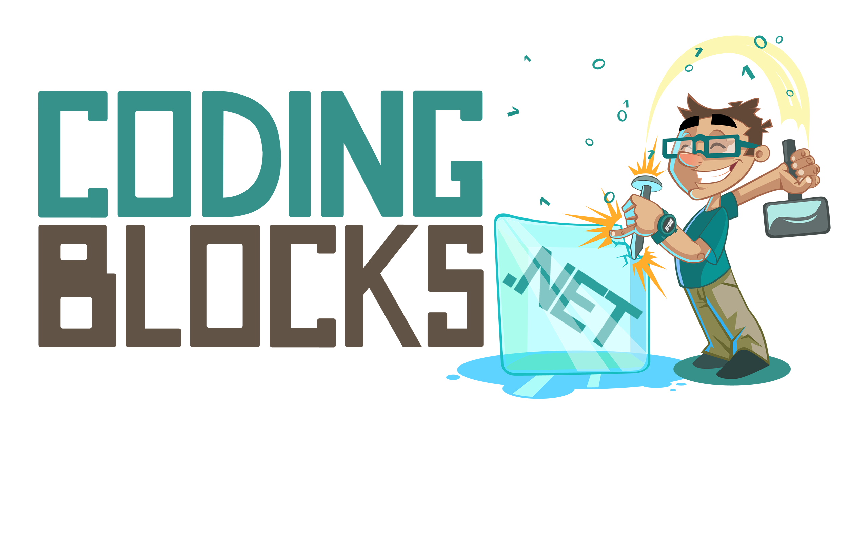
Like this talk? Check out the show!
Joe Zack
@codingblocks
github.com/codingblocks
Notes:
Like this talk? Check out the show!

